Slide 1

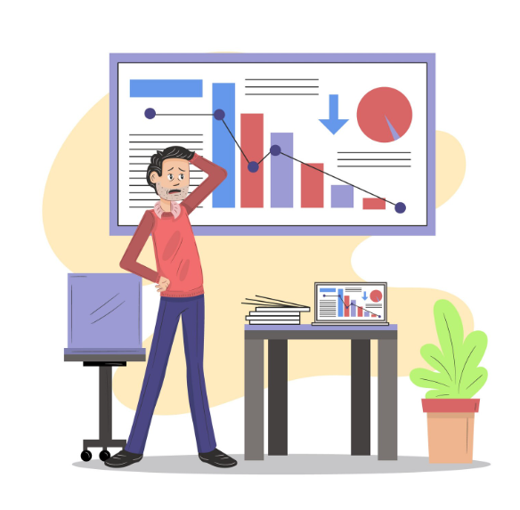
Module 3 Facilitator Recording Deck
Debugging, Optimization, and Code Reviews
Total runtime: 80 minutes across 10 videos
TRAINER ONLY. Do not publish and do not show on camera.
This deck names planted defects. A learner who sees it loses the exercises.
Full narration is in 02-facilitator/recording-script.md.
© Copyright 2026, ZaranTech LLC. All rights reserved.

Slide 2
Video Breakdown
3.1: Cold open on the Module 2 suite, presenting errors, traces, repro steps (8 min)
3.2: Isolating root causes, binary search, ranked hypotheses, alternative fixes (9 min)
3.3: Bottlenecks, quadratic loops, I/O, complexity, memory (10 min)
3.4: Patterns, design, pull request partner, review prompts, human sign-off (8 min)
3.5: Exercise 7 part 1, steps 1 to 6, first failure and the derived range (8 min)
© Copyright 2026, ZaranTech LLC. All rights reserved.

Slide 3
Video Breakdown (cont.)
3.6: Exercise 7 part 2, steps 7 to 10, still red, ranked hypotheses, green (7 min)
3.7: Exercise 8 part 1, steps 1 to 5, baseline and diagnosis (7 min)
3.8: Exercise 8 part 2, steps 6 to 10, optimise, verify, then time (8 min)
3.9: Exercise 9 part 1, steps 1 to 4, your own read and Round 1 scored (8 min)
3.10: Exercise 9 part 2, steps 5 to 10, Round 2 and the comparison (7 min)
© Copyright 2026, ZaranTech LLC. All rights reserved.

Slide 4
Video 3.1: A Green Suite That Is Not Finished
8 minutes | terminal, then deck
Show: Terminal, cd into the Exercise 6 starter folder, pytest -v, green.
Show: The expected-to-fail line, cursor on it.
Show: Editor, the marker removed. Terminal, pytest -v again, red.
Show: Slides 1 to 4.
© Copyright 2026, ZaranTech LLC. All rights reserved.

Slide 5
Video 3.1: A Green Suite That Is Not Finished (cont.)
Watch out: If your finished Exercise 6 suite has no expected-to-fail test in it, do not
Watch out: Do not repair the utility module to make the red line go away. It is a teaching
Watch out: Scrollback. This is the first terminal shot of the module and anything above
© Copyright 2026, ZaranTech LLC. All rights reserved.

Slide 6
Video 3.2: Root Causes and Ranked Hypotheses
9 minutes | deck
Show: Slides 8, 9, 10, 11 at an even pace, roughly two minutes each.
Watch out: Four dense slides with no screen cut is the flattest stretch in the module. Vary
Watch out: Do not demonstrate a debugging prompt here. Exercise 7 does it against a real
Watch out: Do not extend slide 9 into a version control demonstration. The commit-bisect
© Copyright 2026, ZaranTech LLC. All rights reserved.

Slide 7
Video 3.3: Performance, and the Word That Costs You...
10 minutes | deck
Show: Slide 12.
Show: Slide 13, held for four minutes. Say the numbers out loud: ten times the data,
Show: Slides 14, 15, 16.
Watch out: Do not say "exponential" anywhere in this video, including as the wrong
© Copyright 2026, ZaranTech LLC. All rights reserved.

Slide 8
Video 3.3: Performance, and the Word That Costs You... (cont.)
Watch out: Do not open a terminal to demonstrate timing here. Exercise 8 is the
Watch out: Do not quote a specific speedup multiple in this video. The number belongs to
© Copyright 2026, ZaranTech LLC. All rights reserved.

Slide 9
Video 3.4: Review, and Who Signs Off
8 minutes | deck
Show: Slides 17, 18.
Show: Slides 19, 20, 21, 22.
Show: Slide 23, held slightly longer.
Show: Slides 24, 25, 26.
© Copyright 2026, ZaranTech LLC. All rights reserved.

Slide 10
Video 3.4: Review, and Who Signs Off (cont.)
Watch out: Do not use an emoji on screen or in narration anywhere in this module. The deck
Watch out: Do not overclaim what a review prompt catches. Everything in Exercise 9 is
Watch out: Do not turn slide 24 into a policy statement about the learner's employer. Say
© Copyright 2026, ZaranTech LLC. All rights reserved.

Slide 11
Video 3.5: Exercise 7 Part 1, One Fix Is Not the Fix
8 minutes | terminal, plus browser and editor
Show: Terminal, pytest -v, the full output with all three failures visible.
Show: Notes file, the four facts, with the failure count written down.
Show: Terminal, the whole failing section selected and copied.
Show: Browser, the root cause prompt with the function and the full traceback pasted.
© Copyright 2026, ZaranTech LLC. All rights reserved.

Slide 12
Video 3.5: Exercise 7 Part 1, One Fix Is Not the Fix (cont.)
Watch out: The count on screen must be three failures. If it is one or two, the
Watch out: Do not say the admissible range out loud before the derivation. Deriving it is
Watch out: Do not edit test_buggy_inventory.py at any point, and do not let a prompt
© Copyright 2026, ZaranTech LLC. All rights reserved.

Slide 13
Video 3.6: Exercise 7 Part 2, Still Red
7 minutes | terminal, plus browser and editor
Show: Terminal, pytest -v, the exception gone and one failure remaining. Hold this
Show: Terminal, the remaining failure section, showing the actual and expected values.
Show: Browser, the ranked hypotheses prompt and its three ranked answers.
Show: Terminal, the cheap check for hypothesis one, run live.
© Copyright 2026, ZaranTech LLC. All rights reserved.

Slide 14
Video 3.6: Exercise 7 Part 2, Still Red (cont.)
Watch out: Do not fix both problems in Part 1 and then show a single green run. The whole
Watch out: Do not name the arithmetic mistake in the second defect before the ranked
Watch out: git diff will show your Part 1 change as well. That is fine and it is the
© Copyright 2026, ZaranTech LLC. All rights reserved.

Slide 15
Video 3.7: Exercise 8 Part 1, Measure Before You Touch...
7 minutes | terminal, plus browser
Show: Terminal, python slow_lookup.py. Let the elapsed time land.
Show: Notes file, both numbers written in.
Show: Editor, count_matches, including the docstring, with the cursor on the
Show: Notes file or editor, the comparison count written out: 12,000 times 12,000.
© Copyright 2026, ZaranTech LLC. All rights reserved.

Slide 16
Video 3.7: Exercise 8 Part 1, Measure Before You Touch... (cont.)
Watch out: The match count on screen must be 24326. That number is the correctness
Watch out: Elapsed time is machine dependent. Roughly two to three seconds is the target.
Watch out: Do not say what the wrong optimisation returns. That number belongs in the next
© Copyright 2026, ZaranTech LLC. All rights reserved.

Slide 17
Video 3.8: Exercise 8 Part 2, The Fast Wrong Answer
8 minutes | terminal, plus browser and editor
Show: Browser, the optimisation prompt. Editor, fast_lookup.py saved.
Show: Notes file, the two predictions written before anything is run.
Show: Editor, compare_lookup.py typed or pasted, with the assertion visible above
Show: Terminal, python compare_lookup.py. Hold the output.
© Copyright 2026, ZaranTech LLC. All rights reserved.

Slide 18
Video 3.8: Exercise 8 Part 2, The Fast Wrong Answer (cont.)
Watch out: Check correctness before celebrating the speedup, on camera, in that order.
Watch out: Do not quote the speedup multiple as a property of the technique. Say "on this
Watch out: Do not skip step 7's prediction because you already know the answer. It is the
© Copyright 2026, ZaranTech LLC. All rights reserved.

Slide 19
Video 3.9: Exercise 9 Part 1, The Prompt People Actually...
8 minutes | editor, plus browser
Show: Editor, sample_pr.diff, scrolled top to bottom at reading pace. Pause on the
Show: Notes file, the numbered list built live, five or six items.
Show: Browser, a genuinely new conversation. The three-word prompt, then the diff
Show: The Round 1 response, scrolled through once.
© Copyright 2026, ZaranTech LLC. All rights reserved.

Slide 20
Video 3.9: Exercise 9 Part 1, The Prompt People Actually... (cont.)
Watch out: Do not add anything to the Round 1 prompt, not even a polite framing sentence.
Watch out: Start a genuinely new conversation. Context from an earlier chat quietly shapes
Watch out: Do not narrate what Round 1 "should" find. Read what it did find. The lab
© Copyright 2026, ZaranTech LLC. All rights reserved.

Slide 21
Video 3.10: Exercise 9 Part 2, Same Diff, Different Review
7 minutes | browser, plus notes
Show: Notes file, Round 1's tallies, as the opening frame.
Show: Browser, new conversation, the Round 2 prompt, then the same diff pasted
Show: The Round 2 response, grouped, scrolled once.
Show: Notes file, the comparison table filled with real numbers from both rounds.
© Copyright 2026, ZaranTech LLC. All rights reserved.

Slide 22
Video 3.10: Exercise 9 Part 2, Same Diff, Different Review (cont.)
Watch out: Both rounds must be in separate conversations, visibly. If Round 2 runs in
Watch out: Do not paste an edited diff into Round 2. Same bytes, both rounds. Say so on
Watch out: Do not read your comparison numbers as though they were the expected numbers.
© Copyright 2026, ZaranTech LLC. All rights reserved.

Slide 23
What This Module Fails Without
The number of failures and the number of problems are different numbers, and
A test suite is a specification, and when the failing line does not determine
Nested loops grow quadratically, not exponentially, and saying the wrong word in
Correctness is checked before the clock, because a faster wrong answer is worse
Severity, scope and exclusions are the reviewer's job to supply, and an empty
© Copyright 2026, ZaranTech LLC. All rights reserved.

